Slide 1

What is Civilization?
Notes:
ما هي الحضارة؟

Slide 2
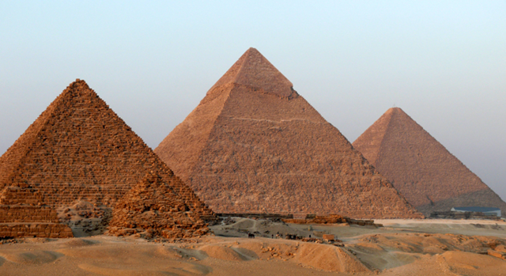



How do we define it?
Culture
Architecture
Urban Centers
Technology

Slide 3
Beginnings of Mankind
Fossils of early bipedal hominids in Africa date to nearly 6 million years ago
As hunters and gatherers, early humans survived by following food and water sources
The necessity of following food sources led to the migration of early humans across regions of Africa
Early humans developed family and clan, or band, units for defense and survival
Notes:
مهد الجنس البشري يعود تاريخ أحفاد بشريين من أوائل القدمين في أفريقيا إلى ما يقرب من 6 ملايين سنة
كصيادين وجامع ، نجا الإنسان الباكر من خلال اتباع مصادر الغذاء والمياه
أدت ضرورة اتباع مصادر الغذاء إلى هجرة البشر الأوائل عبر مناطق إفريقيا
طور البشر في وقت مبكر الأسرة والعشائر ، أو الفرقة ، وحدات للدفاع والبقاء

Slide 4
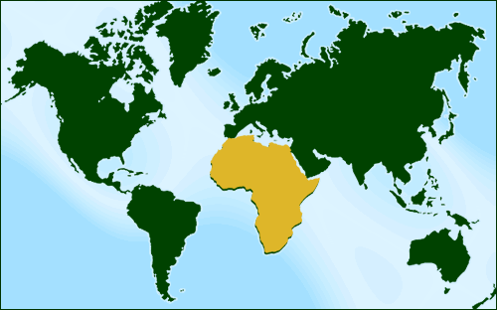
Africa
Covers six percent of the world’s land mass
Second largest continent
Second most populace continent today
Oldest inhabited land
Origin of the human species
Notes:
يغطي ستة في المائة من كتلة اليابسة في العالم
ثاني أكبر قارة
ثاني أكبر قارة من حيث عدد السكان اليوم
أقدم الأراضي المأهولة بالسكان
أصل الأنواع البشرية

Slide 5
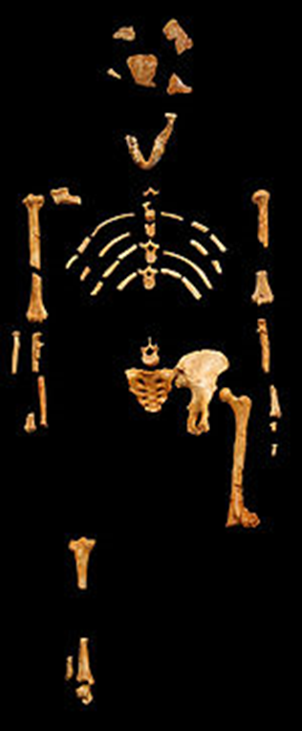
Early Humans
An Australopithecus skeleton named Lucy has been dated to 3.2 million years ago
Lucy was discovered in the Awash Valley of Ethiopia on November 24, 1974
Lucy had a small brain and was bipedal
Notes:
البشر في وقت مبكر
هيكل عظمي أسترالوبيثكس يدعى لوسي يعود تاريخه إلى 3.2 مليون سنة
تم اكتشاف لوسي في وادي أواش في إثيوبيا في 24 نوفمبر 1974
كان لدى لوسي دماغ صغير وكان ذو قدمين

Slide 6
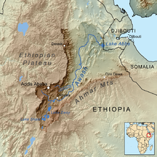
The Cradle of Mankind
Thought to be the oldest occupied land on earth
Origin of early humans around 1.5 – 1.8 million years ago
Modern humans, or homo-sapiens, evolved around 100,000 years ago
Notes:
مهد البشرية
يعتقد أن أقدم الأراضي المحتلة على الأرض
أصل البشر في وقت مبكر حول 1.5 - 1.8 مليون سنة مضت
تطور الإنسان الحديث ، أو الإنسان العاقل ، منذ حوالي 100000 عام

Slide 7
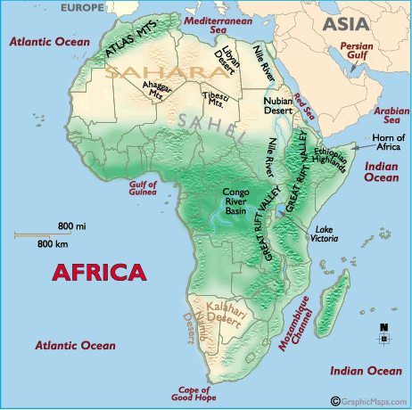
Early Africa
Sahara region occupied by nomadic tribes
Sahara region started becoming more arid around 6000 B.C.E.
Around 5000 B.C.E. peoples began migrating from the Sahara region
By 1000 B.C.E. the Sahara region was a desert dividing Africa

Slide 8
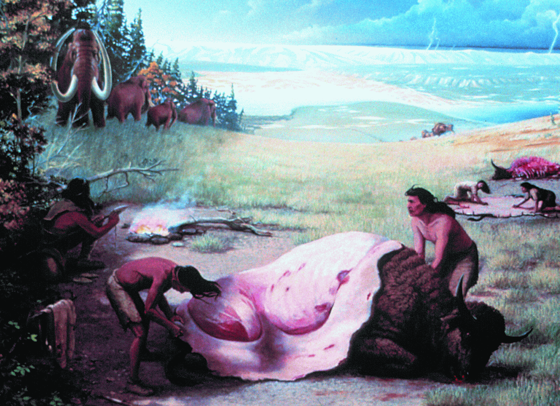
Early Humans
During the Paleolithic Era, or Old Stone Age, 2.6 million years ago to about 12,000 years ago, early humans survived by hunting and gathering
Early humans lived in small family units known as bands or clans
Early humans developed stone tools for specific uses

Slide 9
Paleolithic Era
Human population was low and widespread
Human population was nomadic
New technologies led to bone, stone and wood tools for everyday use
Tools included spears, knives, axes and digging tools
Around 2 million years ago humanoids began migrating from Africa into Eurasia and China

Slide 10
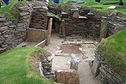
Development of Mankind
During the Neolithic Era, or New Stone Age, 12,000 – 4,000 B.C.E., humans developed social structures, communities and new technologies
Humans became more stationary
New specialized stone tools were developed to assist in everyday life

Slide 11
Neolithic Era
Between 12,000 to 10,000 B.C.E. in areas of the Near East known as the “Fertile Crescent,” people began utilizing wild grains
Advancements in technologies led to settled agriculture, or farming
By 8,000 B.C.E. small farming communities were spread across the Fertile Crescent
Pottery was developed for storing food stuffs

Slide 12
Beginnings of Civilization
The development of systematic agriculture, or farming
The domestication of plants and animals
Establishment of societies and urban centers
Development of political, economic, social, military, cultural, intellectual, religious and scientific structures and institutions
Creation of writing
Creation of the wheel

Slide 13
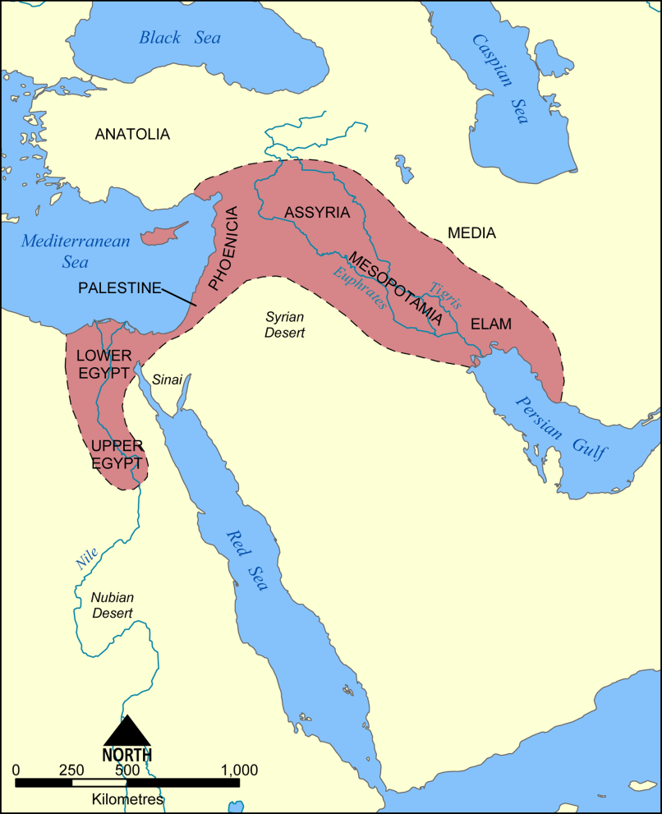
Cradle of Civilization
Between 4000 – 3000 B.C.E. early civilizations were established along the Tigris and Euphrates River Valleys (modern – day Iraq)
About 3000 B.C.E. the Sumerians created cuneiform, a form of writing
These ideas spread to the river valleys of Egypt, India and China

Slide 14
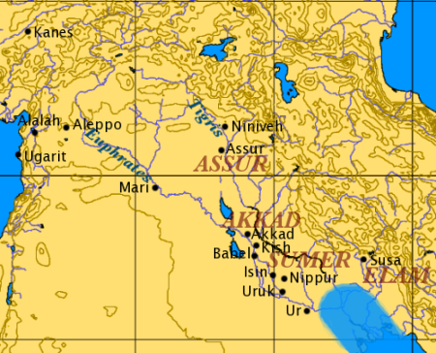
The Sumerians
3000 – 2370 B.C.E.
By 4000 B.C.E. Sumerian communities began to spread throughout Mesopotamia
Uruk, the first city of its kind, was established around 3500 B.C.E.
Dynastic ruling families began to gain control by 2100 B.C.E.

Slide 15
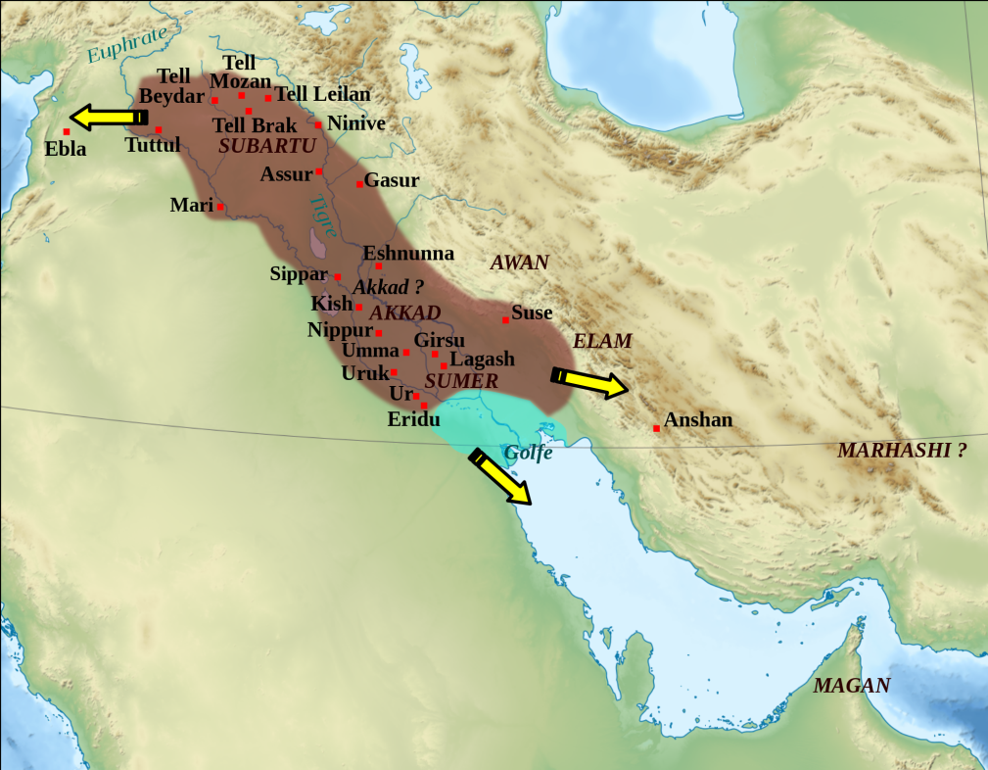
The Akkadians
2334– 2154 B.C.E.
In 2334 B.C.E. Sargon unified all Sumerian speaking peoples under one ruler
His successors gained control over much of Mesopotamia
The empire’s collapse led to a decline of the region

Slide 16
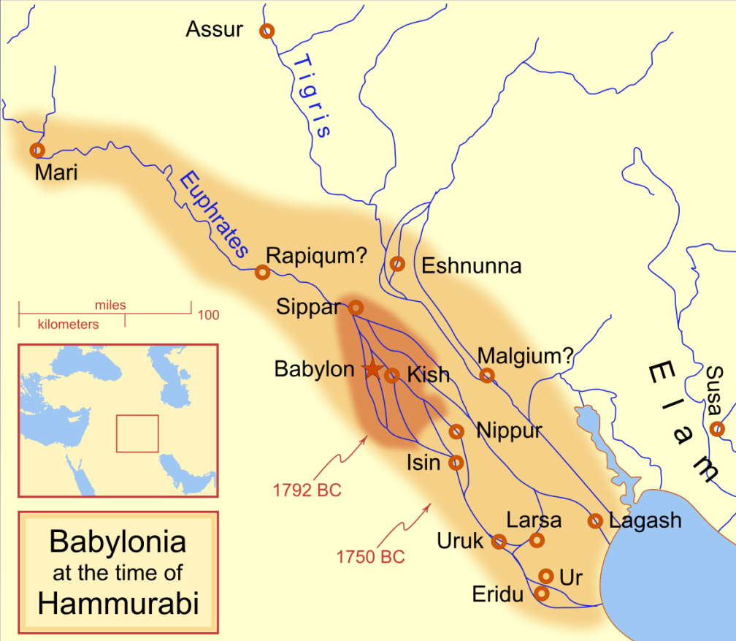
The Amorites/Babylonians
1894 – 1595 B.C.E.
In 1894 B.C.E. the city-state of Babylon emerged as a regional power
Hammurabi (1792 – 1750 B.C.E.) expanded the empire
Declined following the death of Hammurabi

Slide 17
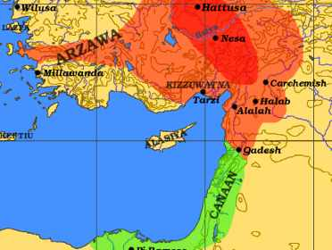
The Hittites
1600 – 1178 B.C.E.
Hittite kingdom was established around 1600 B.C.E.
Internal quarrels limited their expansion
Conquered Babylon in 1531 B.C.E.
Hittite Empire reached its peak around 1350 B.C.E.

Slide 18
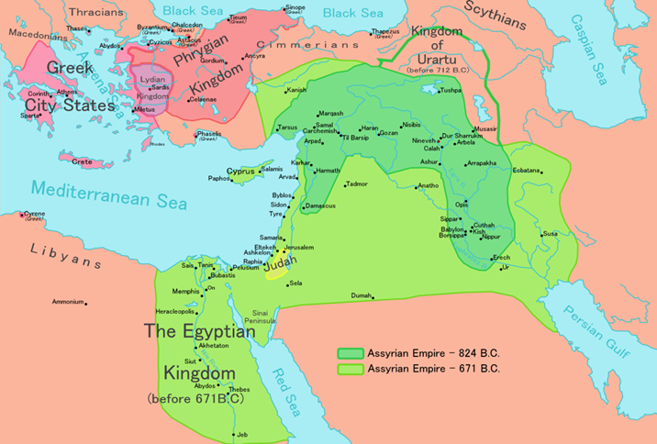
The Assyrians
1000 – 612 B.C.E.
Consolidation of Assyrian power around 1000 B.C.E.
Peak of Assyrian Empire by 665 B.C.E.
Destruction of the capital at Nineveh in 612 B.C.E. marked the end of the empire

